Slide 1
Mexico Power Price Prediction
Predicting Locational Marginal Prices for Mexico Energy Markets

Slide 2
Why?
Energy markets are deregulating across the globe.
Electricity cannot be stored and is traded constantly.
Extreme price volatility for power can exceed two orders of magnitude higher than any other commodity.

Slide 3
The Problem
Build a model that calculates Locational Marginal Prices for markets in Mexico using historical load, price, weather and other data.

Slide 4



Stakeholders
Generation Companies
Utility Companies
Consumers

Slide 5
The Data
Scraped power price and demand data from CFE’s website
Hourly readings from 2016-2021 for Mexico City, Guadalajara, Chihuahua, Monterrey
Distributed Zones – Weighted average of several nodes in the region
Weather data from NOAA
6 readings for each day in each region
Natural Gas Index Prices from EIA
Average daily NG price from Henry Hub, Waha, Houston Ship Channel
Power Price and Demand
NG Price Data
Weather Data
Dataset

Slide 6

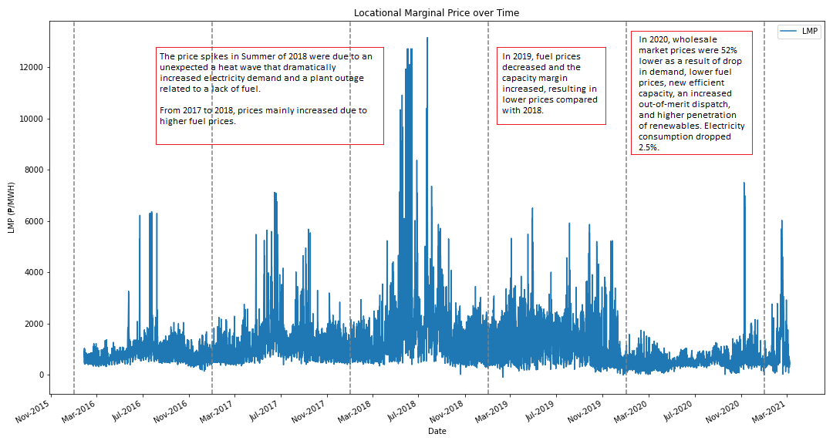




The Target: Locational Marginal Price

Slide 7
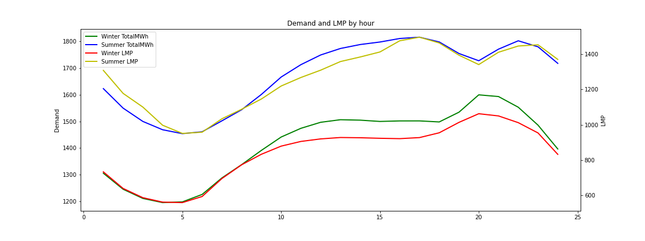
Exploratory Data Analysis
There is a strong relationship between demand and LMP.
The chart reflects how hour of the day and season impact both variables.

Slide 8
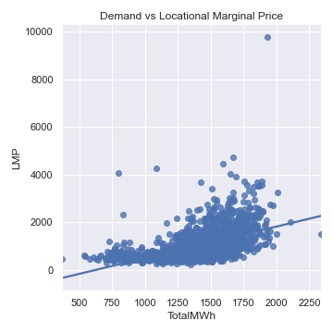
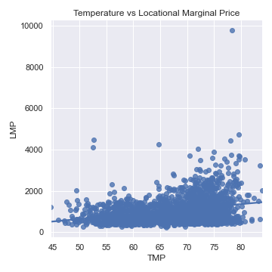
Exploratory Data Analysis
Demand and Temperature have similar effects on Price
Variance increases as both features increase.

Slide 9
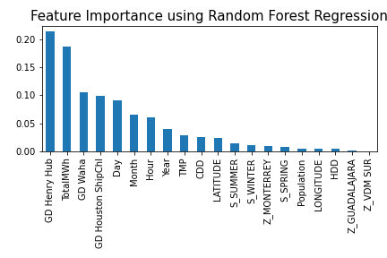
Feature Engineering
Despite the correlations pointed out in the previous slides, Natural Gas Prices are the most impactful feature.
Demand has the 2nd largest impact.

Slide 10
Model Training
Tested four ensemble regression models:
Random Forest Regression
Extra Trees Regression
Gradient Boosting Regression
XGBoost Regression
Randomized 5 fold Cross Validation was used to condense down a large parameter array. Gridsearch was then used to select the ideal parameters from that reduced parameter set.

Slide 11
Modeling Results
ML Algorithm | Training rRMSE(%) | Test rRMSE(%) | R-squared
Extra Trees Regression | 1.52 | 22.86 | 77.61
Random Forest Regression | 9.31 | 20.74 | 81.57
Gradient Boosting Regression | 5.52 | 19.58 | 83.57
XGBoost Regression | 0.27 | 18.25 | 85.72

Slide 12
Residuals over Time of Test Data

Slide 13
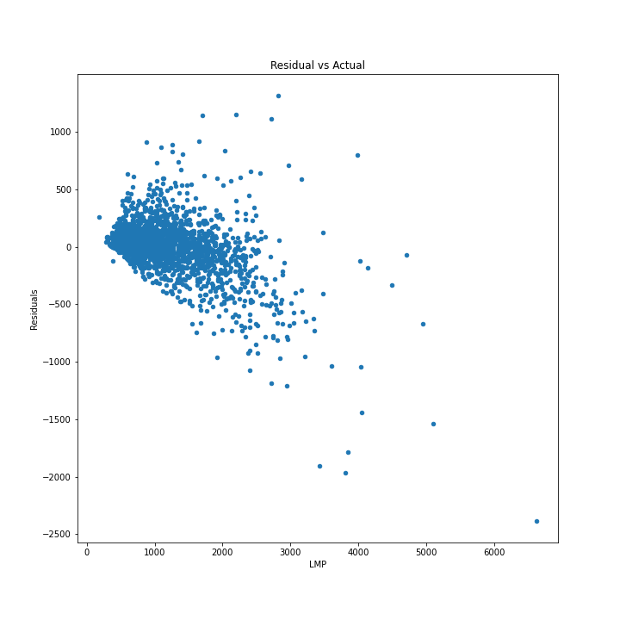
Residual vs Actual
Residuals increase as Price increases.
Variance increases as Price increses
There is no trend line.
Difficult to predict anamolus high price events

Slide 14
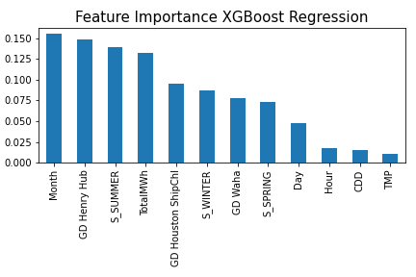
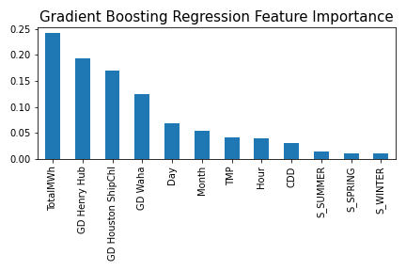
Feature Importance Discrepency
XGBoost model was slightly more accurate but the important features were slightly less intuitve
Gradient Boosting was more in line with market intuition and the other models
Evidence to choose Gradient Boosting over XGBoost

Slide 15
Conclusions and Future Work
Created a fairly accurate pricing model using Demand, Weather, and NG price data. Discovered most important features.
In reality, demand data would not be available at the time of prediction.
Future work to create a separate model to predict demand as an input into this model.

